Slide 1
FOCUSING ON WEB OR APP
Group – 1
Papu maharana, Kommiri prasanna kumar, Mohammed noman quadeer

Slide 2
Contents:
INTRODUCTION
OBJECTIVE
EXPLORATORY DATA ANALYSIS
MODEL BUILDING
MODEL DEPLOYMENT
CONCLUSION

Slide 3
Introduction:
Welcome to the presentation on the Ecommerce Business Strategy Project.
This project aims to assist an Ecommerce company that sells clothing online and offers in-store styling sessions. Customers can interact with personal stylists in-store and later place orders via a mobile app or website.
We utilized data-driven insights to build a predictive model that helps in decision-making, ensuring an optimized strategy for maximizing annual revenue.

Slide 4
Objective:
Analyze customer behavior and spending patterns to determine key factors influencing yearly spending.
Identify whether the mobile app or website contributes more to customer engagement and revenue generation.
Develop a predictive model to estimate yearly spending based on key customer attributes.
Provide insights to help the company decide where to focus mobile app enhancement or website improvements.
Deploy the final model using Streamlit for user-friendly access.

Slide 5
EDA:
Removing unwanted columns.
No missing and duplicate values in any column.
Detecting outliers and handle them using capping method.
Scaling features using Standardscaler for betterment of model training.
Visualization of histogram, heatmap, scatterplot.

Slide 6
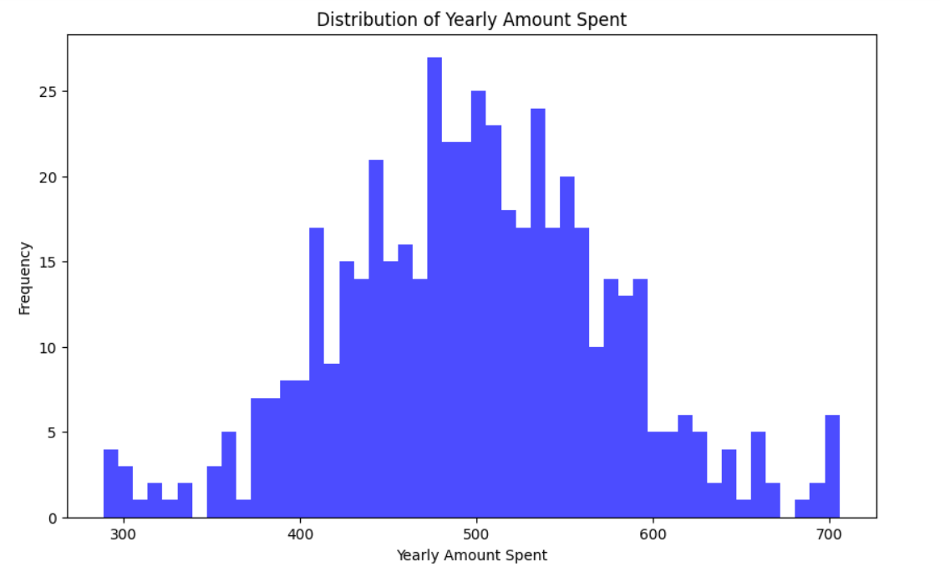
Histogram :

Slide 7
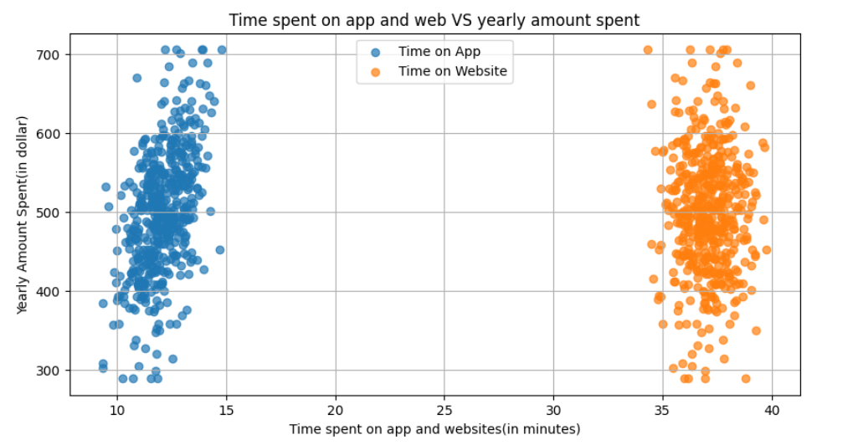
Scatterplot :

Slide 8
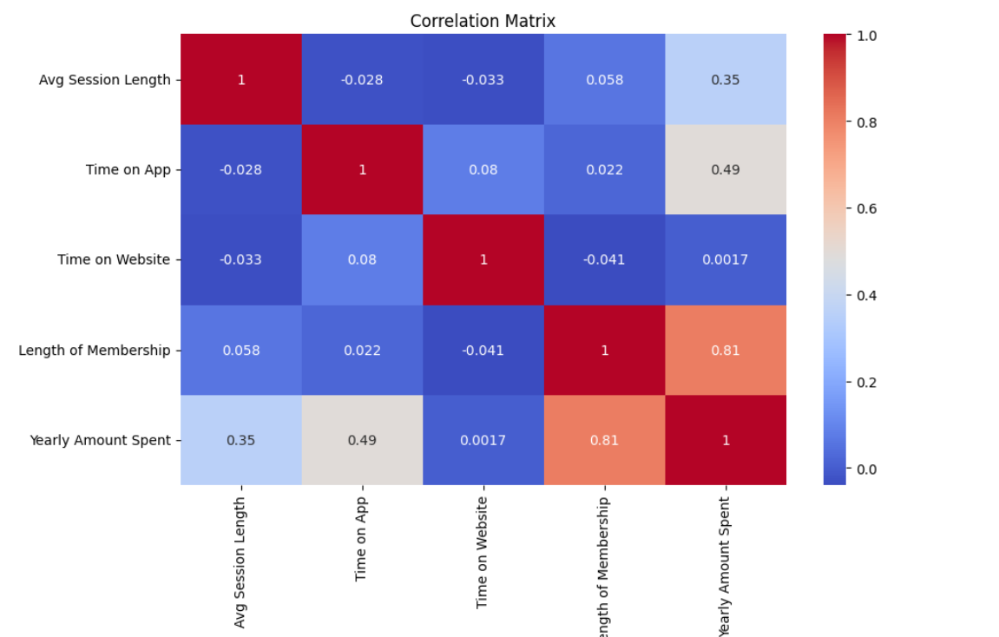
Heatmap:

Slide 9
Insights :
Histogram and scatterplot :
All data are approximately normally distributed, centered around middle, indicating no consistent positive or negative bias.
Heatmap :
Time on App has a higher correlation with target column than Time on Website, the company should focus on improving the mobile app.

Slide 10
Model Building :
Choosing cleaned prepared dataset.
Split the data into training and testing set.
Building different models and train the model using training set.
Make prediction using test sets.
Evaluate the model performance.
Choosing best model by there training, testing score and minimum error.

Slide 11
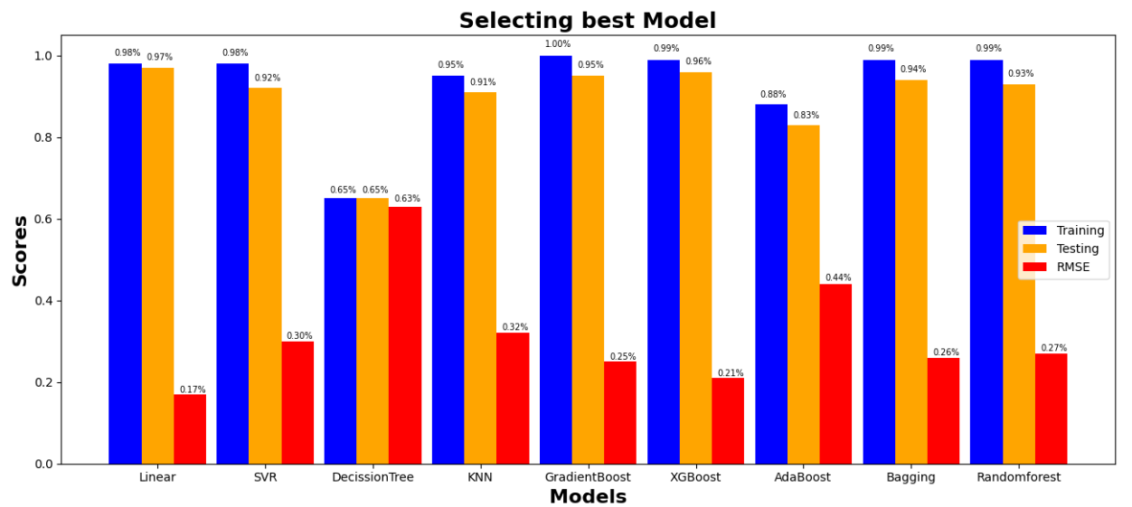
Visualization :

Slide 12
Insights :
Best Generalization : Linear Regression has almost equal training and testing scores, indicating that it generalizes well without overfitting.
Lowest RMSE : The RMSE (~0.17%) is the smallest among all models, meaning its predictions are very close to actual values.
Simplicity & Interpretability : Unlike complex models (e.g., XGBoost, RandomForest), Linear Regression is simple, easy to interpret, and computationally efficient.
So we choose Linear regression model.

Slide 13
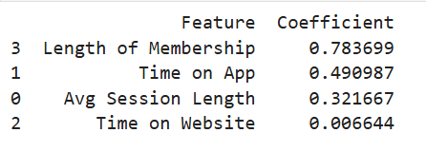
Coefficients :
Features with large coefficients are most important.
Near-zero coefficients may not contribute much.
Time on App has a higher coefficient than Time on Website, the company should focus on improving the mobile app.

Slide 14
Model deployment :
Creating a ‘requirements.txt’ file having all necessary libraries names(Streamlit, pandas, numpy, scikit-learn).
All files(deployment code file, requirements.txt, pickle files) are pushed to github copilot.
Then link to the streamlit cloud with same github repository for the deployment.
Deployed app link :
https://focusingweborapp-j9u3s29nkvrzcpqibpqyxq.streamlit.app/

Slide 15
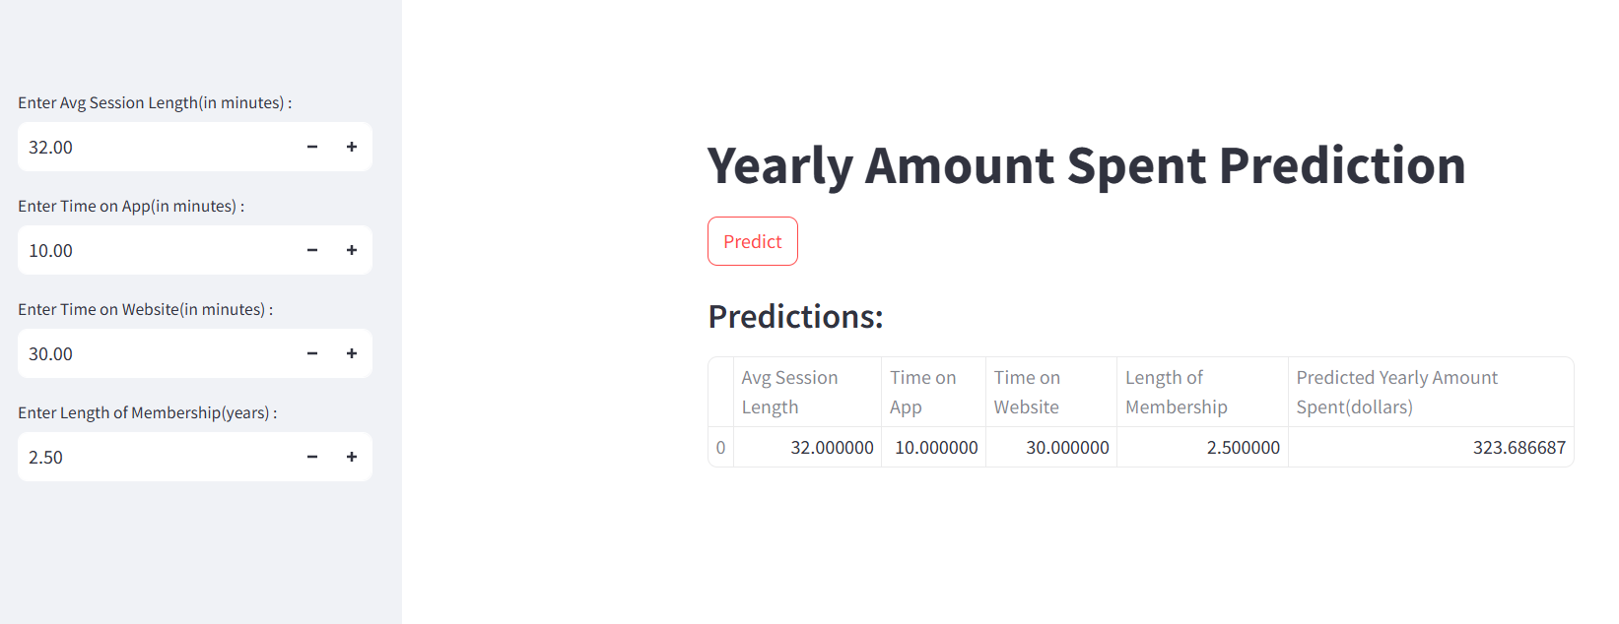
App preview :

Slide 16
Conclusion :
Analyzed Ecommerce data to determine whether to focus on the mobile app or website for better revenue generation.
Explored key factors like session length, time on app, time on website, and membership length.
Identified the most significant factors contributing to Yearly Amount Spent.
Provided recommendations to improve business strategies.
Successfully deployed the model using Streamlit.

Slide 17

Thank You

